Slide 1
Restaurant table booking website
Guided By :
Mrs.M.SENTHAMARAI
PRESENTED By :
SANTHOSH RAJ P
22AIC15 – FULL STACK DEVELOPMENT
22AI047

Slide 2
Abstract
The Restaurant Table Booking Website is a full-stack web application that allows users to search for restaurants, view details such as menus and book tables. It provides a seamless and user-friendly interface for both customers and restaurant owners. By integrating external APIs and using modern web technologies, the platform enhances the dining experience by reducing wait times and simplifying the reservation process

Slide 3
Project Idea:
To build a user-friendly restaurant table booking platform. Users can:
Select the restaurants name, location
View detailed info (menu, ratings, address, opening hours, etc.)
Add restaurants to favorites
Write and read reviews

Slide 4
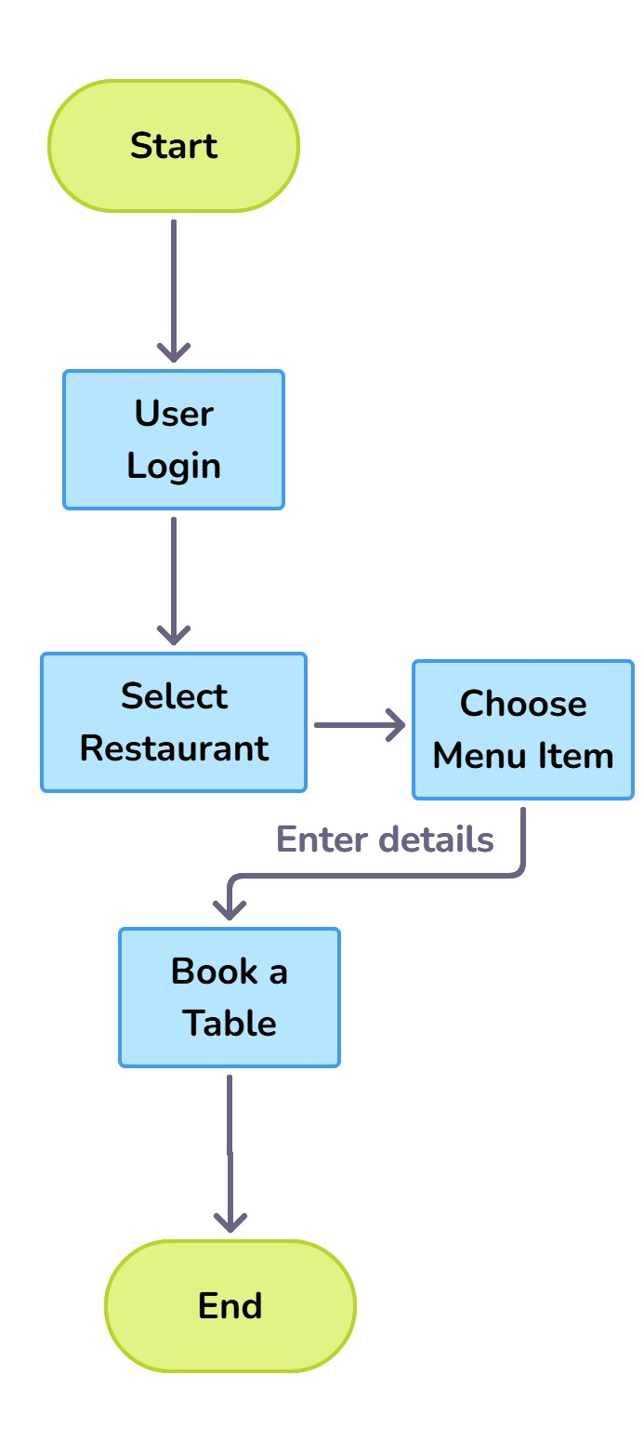
Project Life Cycle:

Slide 5
Languages used:
Frontend: React.js, HTML, CSS, JavaScript
Backend: Node.js, Express.js
Database: MongoDB
API: TMDB with custom RESTful API for restaurant data
Other Tools: VS Code

Slide 6
Modules:
Authentication Module
Restaurant Search Module
Restaurant Details & Booking Module
Booking Management Module

Slide 7
Module Description:
Authentication Module: Manages user registration, login, and secure access to bookings
Restaurant Search Module: Allows users to search for restaurants by name, city.
Restaurant Details & Booking Module:
Displays restaurant info and lets users book tables with date, time, and guest details.
Booking Management Module: Enables users to edit and view, or remove their existing table bookings.

Slide 8
Screen Shots:

Slide 9
Application of the Project:
Online Table Reservations
User Convenience
Improved Restaurant Efficiency
Digital Customer Engagement

Slide 10
References:
Restaurant Table Booking System
Express.js Guide – https://expressjs.com/
React.js Documentation – https://reactjs.org/docs/getting-started.html
Node.js Documentation – https://nodejs.org/en/docs
MongoDB Manual – https://www.mongodb.com/docs/manual/
Mongoose ODM – https://mongoosejs.com/docs/guide.html
W3Schools (HTML, CSS, JavaScript) – https://www.w3schools.com/

Slide 11
Conclusion:
The Restaurant Table Booking Website provides a modern, efficient solution for both customers and restaurant owners. By integrating features like restaurant search, online reservations, and booking management, the system enhances user convenience and operational efficiency. Built with powerful technologies such as React.js, Node.js, and MongoDB, this project demonstrates how digital platforms can transform traditional dining experiences into seamless, user-friendly services.

Slide 12
Future Work:
Real-time Table Availability
Email/SMS Notifications
Admin Dashboard
Mobile App Integration
Payment Gateway Integration

Slide 13
Thank you

